Slide 1

#RahoAmbitious
TechM Full Stack Software Development

Slide 2



Lecture On: HTML Forms
Instructor: Rushabh Shah

Slide 3
In the previous class, we covered…
How to create tables in HTML?
How to create lists in HTML?
How to create dropdowns in HTML?
How to show YouTube videos on your website?
Begin developing the Recipes website.

Slide 4

Today’s Agenda
How to create forms in HTML?
Add ‘Login’ and ‘Contact Us’ features to the
Recipes website.

Slide 5
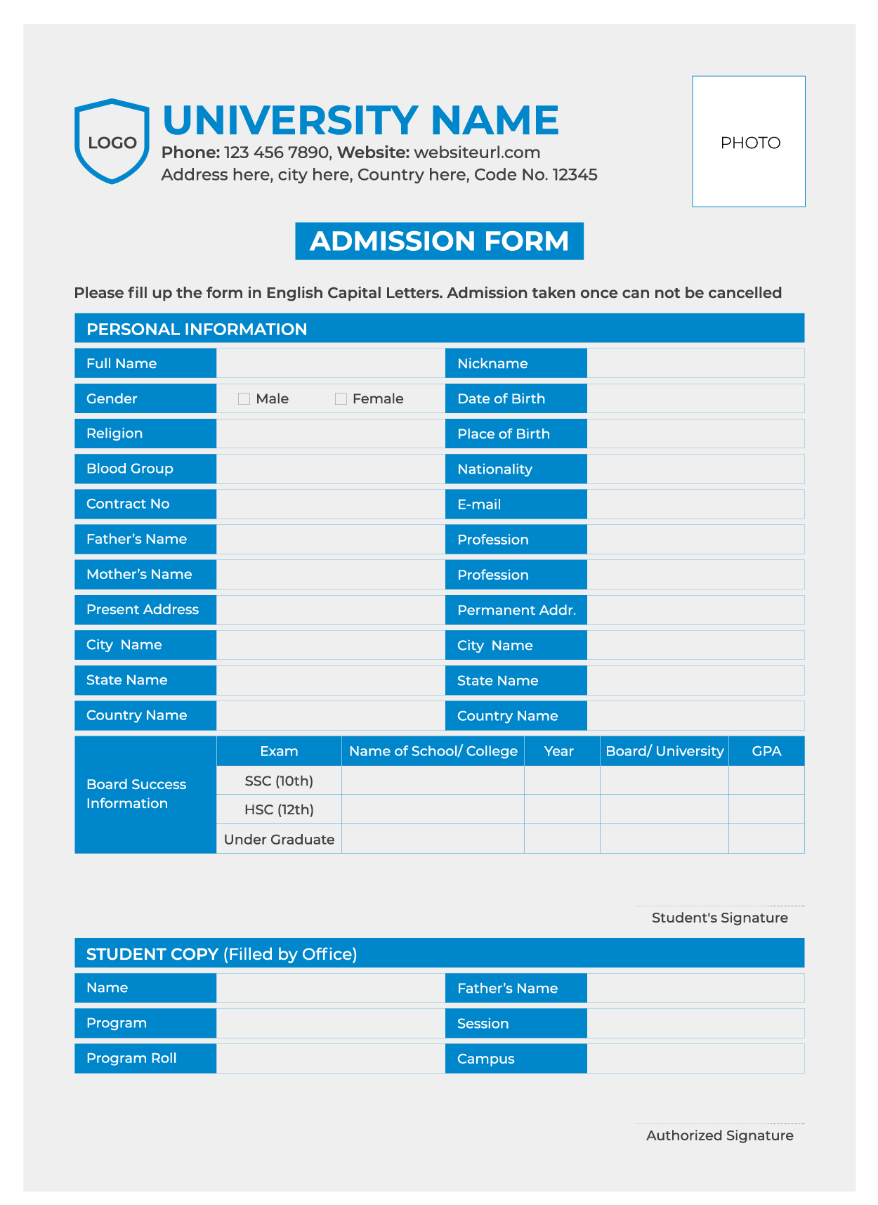
HTML Forms

Slide 6
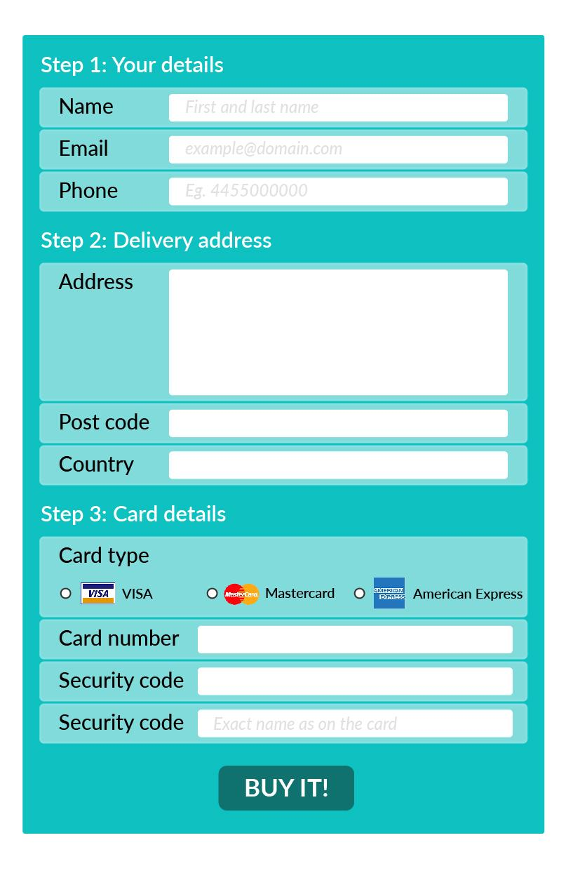
HTML Forms
Introduction to Forms
type=“text”
type=“email”
type=“tel”
textarea
type=“number”
type=“radio”
type=“submit”

Slide 7
HTML Forms
HTML Form Coding Example
<html> <head> <title>Log In</title> </head> <body> <form action=“/action-page.php” method=“get” target=“_blank”> <label for=“name”>Username:</label> <input type=“text” name=“name” id=“name” /> <label for=“password”>Password:</label> <input type=“password” name=“password” id=“password” /> <input type=“checkbox” name=“remember” id=“remember” /> <label for=“remember”>Keep me logged in.</label> <input type=“submit” value=“Login”/> </form> </body> </html>

Slide 8
HTML Forms
The <form> Element
<html> <head> <title>Log In</title> </head> <body> <form action=“index.html” method=“get” target=“_blank”> <label for=“name”>Username:</label> <input type=“text” name=“name” id=“name” /> <label for=“password”>Password:</label> <input type=“password” name=“password” id=“password” /> <input type=“checkbox” id=“remember” /> <label for=“remember”>Keep me logged in.</label> <input type=“submit” value=“Login”/> </form> </body> </html>
Form Attributes
action – It defines the action to be performed when the form is submitted.
method – It defines the HTTP method for submitting data.
target – It defines where the submitted results should open.

Slide 9
HTML Forms
Method: GET vs POST
GET | POST
It is used for requesting data from a resource. | It is used for sending data to the server to update/create a resource.
Form data IS VISIBLE in the URL. | Form data is NOT VISIBLE in the URL.
Clicking the back button will not re-submit the data; hence, it is harmless. | Clicking the back button will re-submit the data; hence, you need to be cautious while using POST.
It can be bookmarked and cached. | It cannot be bookmarked and cached.
The length of the URL is restricted. | There are no restrictions on the length of the URL.
It is Not Secure. | It is Secure.
GET
POST

Slide 10



Poll 1 (15 Sec)
Which of the following is an attribute of the form tag in HTML?
method
action
target
input
Practice in teams of 4 students
Industry expert mentoring to learn better
Get personalised feedback for improvements
11

Slide 11
Poll 1 (Answer)
Which of the following is an attribute of the form tag in HTML?
method
action
target
input
Practice in teams of 4 students
Industry expert mentoring to learn better
Get personalised feedback for improvements
11

Slide 12
Poll 2 (15 Sec)
The ‘method’ attribute in an HTML form:
Defines the action to be performed after form submission.
Specifies whether the result after form submission will open in a new browser tab.
Specifies the HTTP method to be used during form submission
None of the above
Practice in teams of 4 students
Industry expert mentoring to learn better
Get personalised feedback for improvements
11

Slide 13
Poll 2 (Answer)
The ‘method’ attribute in an HTML form:
Defines the action to be performed after form submission
Specifies whether the result after form submission will open in a new browser tab
Specifies the HTTP method to be used during form submission
None of the above
Practice in teams of 4 students
Industry expert mentoring to learn better
Get personalised feedback for improvements
11

Slide 14
Doubt Clearance (5 mins)

Slide 15
HTML Forms
The <input> Element
<input type=“text” />
Allows users to type text.
<input type=“email” />
Allows users to type text in email format, i.e. if the typed text does not contain @ or . as normal email formats do, it will throw up an error message on submitting.
<input type=“password” />
Allows users to type text in password format. The text entered would look like this: ••••••
<input type=“number” />
Allows users to type characters in number format. Users will not be able to type alphabets or any other special character if the input is defined as type number.
<input type=“radio” />
Allows users to include a radio button selection, i.e., choose only one of multiple options provided.
<input type=“checkbox” />
Allows users to include a checkbox selection, i.e., choose multiple options provided.
<input type=“file” />
Allows users to upload files from their local machines.
<input type=“range” />
Allows users to add a range slider between a minimum value and a maximum value.
<input type=“submit” />
Allows users to submit a form.

Slide 16
Poll 3 (15 Sec)
Select whether the following statement is true or false:
<input> is an empty tag.
True
False
Practice in teams of 4 students
Industry expert mentoring to learn better
Get personalised feedback for improvements
11

Slide 17
Poll 3 (Answer)
Select whether the following statement is true or false:
<input> is an empty tag.
True
False
Practice in teams of 4 students
Industry expert mentoring to learn better
Get personalised feedback for improvements
11

Slide 18
Poll 4 (15 Sec)
Which of the following is the correct HTML element for making a checkbox?
<checkbox></checkbox>
<input type=checkbox />
<input type=“checkbox” />
<check />
Practice in teams of 4 students
Industry expert mentoring to learn better
Get personalised feedback for improvements
11

Slide 19
Poll 4 (Answer)
Which of the following is the correct HTML element for making a checkbox?
<checkbox></checkbox>
<input type=checkbox />
<input type=“checkbox” />
<check />
Practice in teams of 4 students
Industry expert mentoring to learn better
Get personalised feedback for improvements
11

Slide 20
Poll 5 (15 Sec)
How can you include a text input field in an HTML form?
<input type=“textfield” />
<textfield />
<input type=“text” />
<textinput />
Practice in teams of 4 students
Industry expert mentoring to learn better
Get personalised feedback for improvements
11

Slide 21
Poll 5 (Answer)
How can you include a text input field in an HTML form?
<input type=“textfield” />
<textfield />
<input type=“text” />
<textinput />
Practice in teams of 4 students
Industry expert mentoring to learn better
Get personalised feedback for improvements
11

Slide 22
HTML Forms
Attributes of the <input> Element
value
It can be used to specify an initial value for an input field.
size
It can used to specify the visible width of the input field box.
min
It specifies the minimum value of the input field.
max
It specifies the maximum value of the input field.
maxlength
It specifies the maximum allowable number of characters.
readonly
It is used to ensure that the input field becomes read-only.
disabled
It is used to disable the field
placeholder
Text written inside the input field when it is empty
required
It is used to mark the input fields as compulsorily before submitting the form.

Slide 23
HTML Forms
Attributes of the <input> Element
Not all the attributes discussed in the last slide are present for all types of input elements.
For Example:
Input field cannot have checked attribute.
Checkbox cannot have min or max attribute.
alt is an attribute specific to images.
autocomplete attribute can be used on all the input types.
You can read more about it here.

Slide 24
Poll 6 (15 Sec)
What does the 'value' attribute specify in an HTML form?
It specifies the initial value of an input field.
It specifies that the value can only be read.
It specifies that the value cannot be changed.
None of the above
Practice in teams of 4 students
Industry expert mentoring to learn better
Get personalised feedback for improvements
11

Slide 25
Poll 6 (Answer)
What does the 'value' attribute specify in an HTML form?
It specifies the initial value of an input field.
It specifies that the value can only be read.
It specifies that the value cannot be changed.
None of the above
Practice in teams of 4 students
Industry expert mentoring to learn better
Get personalised feedback for improvements
11

Slide 26
Poll 7(10 Sec)
Select whether the following statement is true or false:
In an HTML form, radio buttons allow you to choose more than one option.
True
False
Practice in teams of 4 students
Industry expert mentoring to learn better
Get personalised feedback for improvements
11

Slide 27
Poll 7(Answer)
Select whether the following statement is true or false:
In an HTML form, radio buttons allow you to choose more than one option.
True
False
Practice in teams of 4 students
Industry expert mentoring to learn better
Get personalised feedback for improvements
11

Slide 28
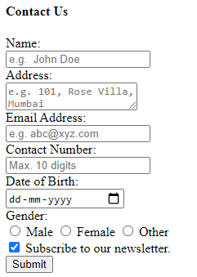
Project -
Contact Us Form

Slide 29

Project Work
(We shall create the Contact Us form for our project using all the required elements.)
You can refer to the solution here.

Slide 30
Doubt Clearance (5 mins)

Slide 31
Poll 8(10 Sec)
Which of the following is the correct HTML element to make a text area?
<input type=“textarea”>
<textarea>
<input type=“text”>
<area>
Practice in teams of 4 students
Industry expert mentoring to learn better
Get personalised feedback for improvements
11

Slide 32
Poll 8(Answer)
Which of the following is the correct HTML element to make a text area?
<input type=“textarea”>
<textarea>
<input type=“text”>
<area>
Practice in teams of 4 students
Industry expert mentoring to learn better
Get personalised feedback for improvements
11

Slide 33
Poll 9(15 Sec)
What is the use of the ‘placeholder’ attribute?
It specifies the minimum value of the input field.
It specifies the maximum value of the input field.
It describes the expected value of the input field.
It describes the actual initial value of the input field.
Practice in teams of 4 students
Industry expert mentoring to learn better
Get personalised feedback for improvements
11

Slide 34
Poll 9(Answer)
What is the use of the ‘placeholder’ attribute?
It specifies the minimum value of the input field.
It specifies the maximum value of the input field.
It describes the expected value of the input field.
It describes the actual initial value of the input field.
Practice in teams of 4 students
Industry expert mentoring to learn better
Get personalised feedback for improvements
11

Slide 35
Poll 10(15 Sec)
What is the use of the ‘required’ attribute in an HTML form?
It ensures that the input field is filled.
It specifies the required value of the input field.
It specifies the maximum number of characters in the input field.
It ensures that the input field can only be read and not written into.
Practice in teams of 4 students
Industry expert mentoring to learn better
Get personalised feedback for improvements
11

Slide 36
Poll 10(Answer)
What is the use of the ‘required’ attribute in an HTML form?
It ensures that the input field is filled.
It specifies the required value of the input field.
It specifies the maximum number of characters in the input field.
It ensures that the input field can only be read and not written into.
Practice in teams of 4 students
Industry expert mentoring to learn better
Get personalised feedback for improvements
11

Slide 37

HTML Forms
Login Forms

Slide 38
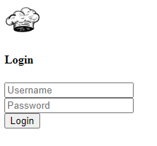
Project -
Login Form

Slide 39
Project Work
(We shall create the Login form for our project using all the required elements.)
You can refer to the solution here.

Slide 40
Poll 11(15 Sec)
<button> is a valid tag?
Yes
No
Practice in teams of 4 students
Industry expert mentoring to learn better
Get personalised feedback for improvements
11

Slide 41
Poll 11(15 Sec)
<button> is a valid tag?
Yes
No
Practice in teams of 4 students
Industry expert mentoring to learn better
Get personalised feedback for improvements
11

Slide 42
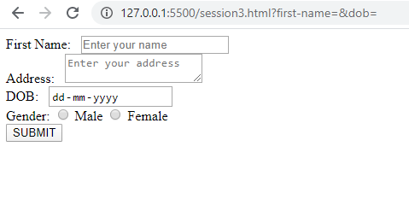
Hands-On Exercise (5 mins)
Write an HTML code for the output shown below:
The stub code is here.
The solution is here.

Slide 43
Key Takeaways
You can create forms using input, textarea and buttons.
Based on the use, input types are of many kinds, ranging from text to number to submit button.
The action attribute in the form element specifies what should happen after a form is submitted.
Form methods can be either GET or POST.
The GET method is used for requesting data, although it is not a secure method, since data can be seen in the URL. POST is used for updating/creating a resource, and it is quite a secure method.
The input elements have different attributes and not all attributes can be used on all input types.

Slide 44
Doubts Clearance (5 mins)

Slide 45
Tasks to Complete after Today’s Session
MCQs
Coding Questions
Project - Checkpoint 3

Slide 46
In the next class...
Introduction to HTML5
New semantic elements introduced in HTML5
Introduction to CSS
How to add CSS and styling to your website?
CSS heights, widths and units

Slide 47
#RahoAmbitious
Thank You!

